Slide 1
A brief overview of the Morph protocol

Slide 2
How do Morph and web services compare?
Morph is designed for OO languages
Morph is not a SOA
Morph capabilities go beyond web services

Slide 3
Capabilities of Morph
Remote Method Invocation
Objects by value and by reference
Streaming
Sessions
Security (encryption, compression, validation)
IPv4, IPv6
Platform independent
Lightweight (ex. .Net version is 165KB)
Application level routing
etc.

Slide 4
Concepts
Message structure
Service vs. Apartment
Servlets

Slide 5
Message structure:
Chain of links
Link types:
Envelope (Message link)
Link (other links)

Slide 6
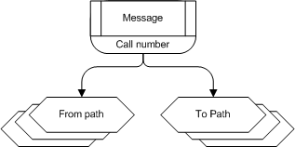

Chain of links
Message link
Call
Reply

Slide 7
Service vs. Apartment
Service is apartment factory
Apartment is logical memory space
Apartments can be shared

Slide 8
Servlets
Each servlet provides apartment access to a business object
Service apartments have a Default servlet

Slide 9
Examples:
Setting up a service
Calling a service
Calling a servlet
Two way RMI

Slide 10
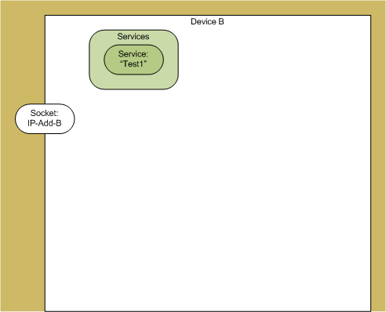
1. Setting up a service

Slide 11
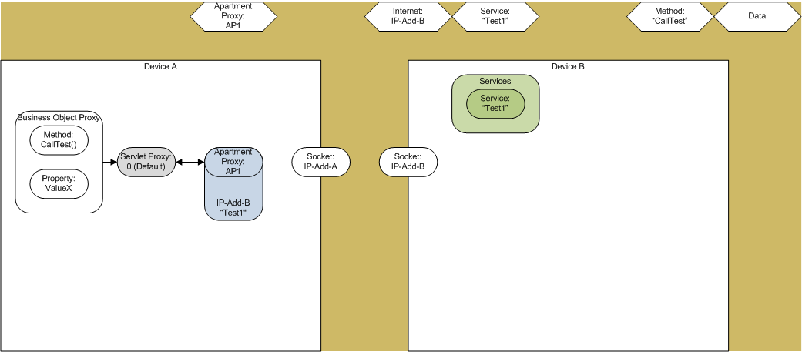
2.a. Calling a service

Slide 12
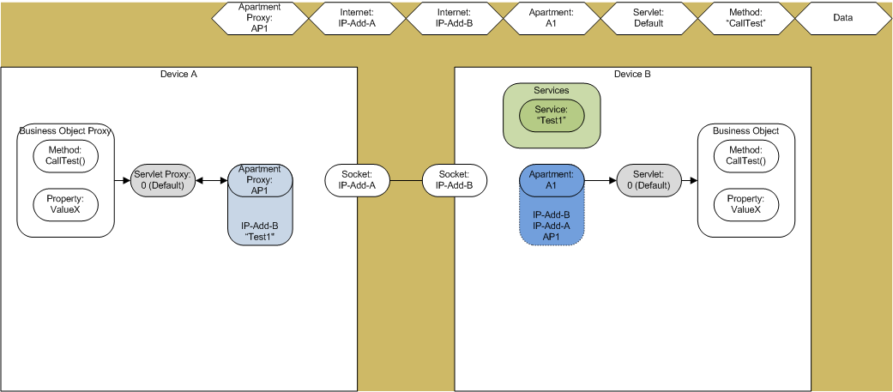
2.b. Service called

Slide 13
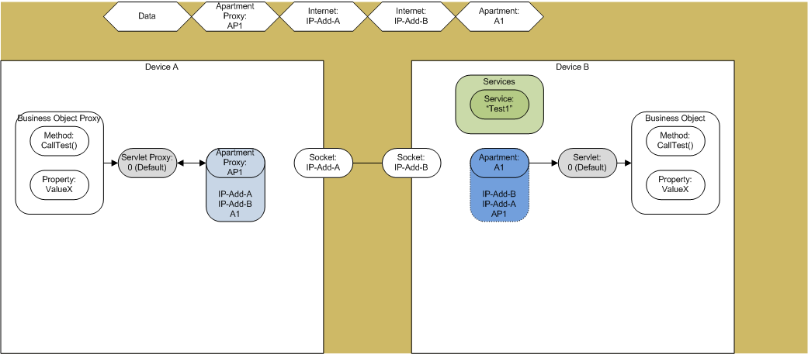
2.c. Service reply

Slide 14
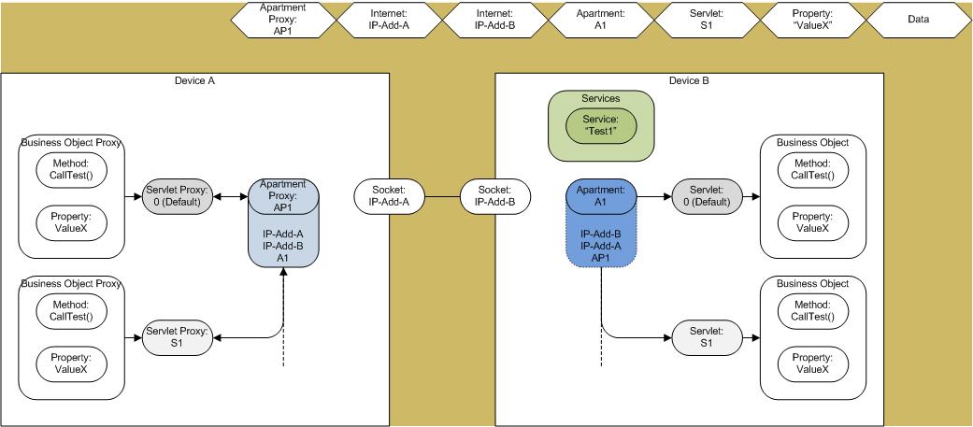
3.a. Calling a servlet

Slide 15
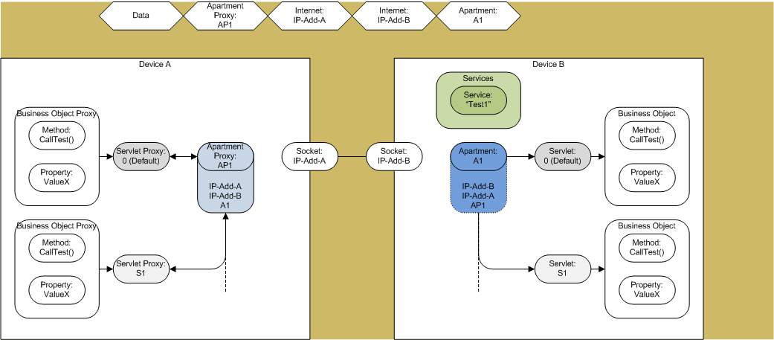
3.b. Servlet replied

Slide 16
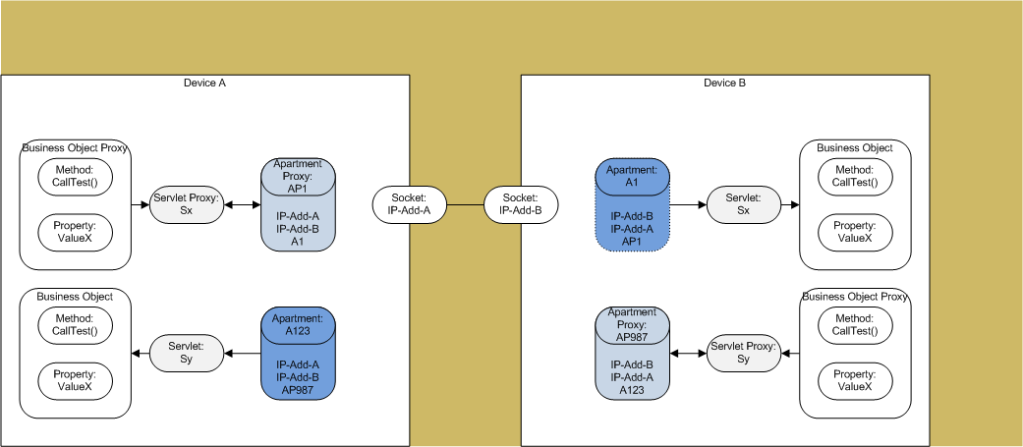
4. Two way RMI

Slide 17
Current state of Morph

Slide 18
RMI
Methods and properties
Synchronous and asynchronous calls

Slide 19
Parameter types
Objects by value
Objects by reference
Streams by reference
Some base types
Arrays and/or Structs of all the above

Slide 20
Exceptions
Remote application exceptions
Morph errors

Slide 21
Links
End
Message
Data
Service/Apartment
Servlet
Method/Property
Stream
Sequence
Internet
Process
Encoding
Information

Slide 22
Platforms
C# (using Mono/Visual Studio)
C
Delphi XE2
Java
Others…

Slide 23
Future plans
Is it useful to others?
Moving ahead
Open source
Public domain
Commercial
Other…?

